Slide 1
Establishing an Enterprise Security API to Reduce Application Security Costs
Jeff Williams
Aspect CEO and Founder
Volunteer Chair of OWASP
jeff.williams@aspectsecurity.com
410-707-1487

Slide 2
The Problem…
Spring
Write Custom Code
Jasypt
Java Pattern
Java URL
Encoder
Commons
Validator
xml-enc
Log4j
Cryptix
JAAS
ACEGI
Stinger
JCE
Struts
BouncyCastle
Reform
Anti-XSS
Many More
HDIV
Standard Control
xml-dsig
Java Logging
Notes:
Even if these libraries did everything you need, they’re not integrated, intuitive, or even correct.

Slide 3
Vulnerability Theory
A risk is a path from threat agent to business impact
Threat Agent
Vector
Vulnerability
Control
Technical Impact
Business Impact
Vector
Business
Impact
Vector
Vulnerability
Control
Asset
Business
Impact
Vector
Vulnerability
Missing
Control
Function
Business
Impact
Vector
Vulnerability
Asset
Vector
Vulnerability
Control
Notes:
Threat agent – a class of attackers
Vector – an attack used by an attacker, or the way a non-malicious threat agent causes a vulnerability to be exploited
Vulnerability – a weakness in an IT system – generally a missing, broken, or ignored security control
Technical Impact – the direct technical result of a successful attack on the system
Business Impact – the resulting effect on the business
The important thing to see here is that security analysis is the process of attempting to find the important risks in a sea of less important ones. We’re searching for the “paths” through the model that have enough likelihood and impact to make it worth doing something about.
Some people are natural at this process. They find vulnerabilities in everything – software, buildings, people, even Starbucks. The other 99% of people – including almost all developers – just don’t think this way. Most people are focused on making things work. They don’t think about all the ways that someone malicious might make something break. In the classes I teach, I’ve found that developers are genuinely surprised that people think that way.

Slide 4
More Vulnerability Theory
Every vulnerability stems from….
Missing control
  Lack of encryption
  Failure to perform access control
Broken control
  Weak hash algorithm
  Fail open
Ignored Control
  Failure to use encryption
  Forgot to use output encoding

Slide 5


Time to Stamp Out Homegrown Controls
Security controls are very difficult to get right
  Requires extensive understanding of attacks
One was built with stuff “Larry” had lying around!

Slide 6
Imagine an Enterprise Security API
All the security controls a developer needs
Standard
Centralized
Organized
Integrated
High Quality
Intuitive
Tested
Solves the problems of missing and broken controls

Slide 7
Ignored Controls
Not solved but we can make it far simpler…
  Coding Guidelines
  Static Analysis
  Developer Training
  Unit Testing
  Etc…

Slide 8
Enterprise Security API
Custom Enterprise Web Application
Authenticator
User
AccessController
AccessReferenceMap
Validator
Encoder
HTTPUtilities
Encryptor
EncryptedProperties
Randomizer
Logger
IntrusionDetector
Enterprise Security API
Exception Handling
SecurityConfiguration
Existing Enterprise Security Services/Libraries
8

Slide 9
Validation, Encoding, and Injection
Global Validate
Any Interpreter
Canonicalize
Specific Validate
Controller
Business Functions
Data Layer
Sanitize
Web Service
Any Encoding
Database
User
Mainframe
Etc…
User
Interface
File System
Set Character Set
Canonicalize
Encode For HTML
Validate
Notes:
The attacker can send data in any encoding. And the interpreters downstream from your application may decide to handle any encoding.
Canonicalize
Input could be in any character set
Double-encoding
Multiple encoding schemes
Double-encoding with multiple encoding schemes
Validation
Simple to configure for positive rules
Impossible to do perfectly, since you need special characters
GetSafeValue
Rich content – strip out bad stuff and continue
Difficult – need to fully parse HTML
Canonicalize and Validate from database
Watch out mass SQL injection?
EncodeForHTML
Not perfect since browsers allow encoded characters to execute (particularly in attributes)
Have to avoid double-encoding
SetCharacterSet
Browser will try to guess the encoding

Slide 10
Handling Validation, and Encoding
User
Controller
Business Functions
Data Layer
Backend
isValidCreditCard
encodeForJavaScript
isValidDataFromBrowser
Validator
Encoder
encodeForVBScript
isValidDirectoryPath
encodeForURL
isValidFileContent
encodeForHTML
isValidFileName
encodeForHTMLAttribute
isValidHTTPRequest
encodeForLDAP
isValidListItem
Canonicalization
encodeForDN
isValidRedirectLocation
Double Encoding Protection
encodeForSQL
isValidSafeHTML
Sanitization
encodeForXML
isValidPrintable
Normalization
encodeForXMLAttribute
safeReadLine
encodeForXPath
Notes:
The attacker can send data in any encoding. And the interpreters downstream from your application may decide to handle any encoding.
Canonicalize
Input could be in any character set
Double-encoding
Multiple encoding schemes
Double-encoding with multiple encoding schemes
Validation
Simple to configure for positive rules
Impossible to do perfectly, since you need special characters
GetSafeValue
Rich content – strip out bad stuff and continue
Difficult – need to fully parse HTML
Canonicalize and Validate from database
Watch out mass SQL injection?
EncodeForHTML
Not perfect since browsers allow encoded characters to execute (particularly in attributes)
SetCharacterSet
Browser will try to guess the encoding

Slide 11
Handling Authentication and Users
User
Controller
Business Functions
Data Layer
Backend
Roles
ESAPI
Strong Passwords
CSRF Tokens
Random Tokens
Lockout
Authentication
Access
Control
Logging
Intrusion
Detection
Remember Me
Timeout
Screen Name
Users

Slide 12
Handling Access Control
isAuthorizedForURL
isAuthorizedForData
Controller
Business Functions
Data Layer
Web Service
isAuthorizedForFunction
isAuthorizedForService
Database
User
Mainframe
Etc…
User
Interface
isAuthorizedForFile
File System
isAuthorizedForFunction

Slide 13
Handling Direct Object References
http://app?id=9182374
http://app?id=1
Access Reference Map
Acct:9182374
http://app?file=7d3J93
Web Service
Database
User
Mainframe
Etc…
Report123.xls
File System
Indirect References
Direct References

Slide 14
Handling Sensitive Information
User
Controller
Business Functions
Data Layer
Backend
Encrypted Properties
Encryptor
Integrity Seals
Encryption
Strong GUID
Digital Signatures
Safe Config Details
Random Tokens
Timestamp
Salted Hash
Notes:
The attacker can send data in any encoding. And the interpreters downstream from your application may decide to handle any encoding.
Canonicalize
Input could be in any character set
Double-encoding
Multiple encoding schemes
Double-encoding with multiple encoding schemes
Validation
Simple to configure for positive rules
Impossible to do perfectly, since you need special characters
GetSafeValue
Rich content – strip out bad stuff and continue
Difficult – need to fully parse HTML
Canonicalize and Validate from database
Watch out mass SQL injection?
EncodeForHTML
Not perfect since browsers allow encoded characters to execute (particularly in attributes)
SetCharacterSet
Browser will try to guess the encoding

Slide 15
Handling Exceptions, Logging, and Detection
User
Controller
Business Functions
Data Layer
Backend
User Message
(no detail)
Enterprise Security Exceptions
Logger
Log Message
(w/Identity)
AccessControlException
AuthenticationException
AvailabilityException
EncodingException
EncryptionException
ExecutorException
IntegrityException
IntrusionException
ValidationException
Intrusion
Detector
Configurable Thresholds
Responses
Log Intrusion
Logout User
Disable Account

Slide 16
Handling HTTP
User
Controller
Business Functions
Data Layer
Backend
Add Safe Header
HTTP Utilities
sendSafeForward
No Cache Headers
sendSafeRedirect
Set Content Type
Add Safe Cookie
Kill Cookie
isSecureChannel
Encrypt State in Cookie
Change SessionID
Safe Request Logging
Hidden Field Encryption
CSRF Tokens
Safe File Uploads
Querystring Encryption
Notes:
The attacker can send data in any encoding. And the interpreters downstream from your application may decide to handle any encoding.
Canonicalize
Input could be in any character set
Double-encoding
Multiple encoding schemes
Double-encoding with multiple encoding schemes
Validation
Simple to configure for positive rules
Impossible to do perfectly, since you need special characters
GetSafeValue
Rich content – strip out bad stuff and continue
Difficult – need to fully parse HTML
Canonicalize and Validate from database
Watch out mass SQL injection?
EncodeForHTML
Not perfect since browsers allow encoded characters to execute (particularly in attributes)
SetCharacterSet
Browser will try to guess the encoding

Slide 17
Handling Application Security Configuration
User
Controller
Business Functions
Data Layer
Backend
ESAPI
ESAPI Configuration
Select crypto algorithms
Select encoding algorithms
Define sets of characters
Define global validation rules
Select logging preferences
Establish intrusion detection thresholds and actions
Etc…

Slide 18
Coverage
A1. Cross Site Scripting (XSS)
A2. Injection Flaws
A3. Malicious File Execution
A4. Insecure Direct Object Reference
A5. Cross Site Request Forgery (CSRF)
A6. Leakage and Improper Error Handling
A7. Broken Authentication and Sessions
A8. Insecure Cryptographic Storage
A9. Insecure Communications
A10. Failure to Restrict URL Access
OWASP Top Ten
OWASP ESAPI
Validator, Encoder
Encoder
HTTPUtilities (Safe Upload)
AccessReferenceMap, AccessController
User (CSRF Token)
EnterpriseSecurityException, HTTPUtils
Authenticator, User, HTTPUtils
AccessController
Encryptor
HTTPUtilities (Secure Cookie, Channel)

Slide 19
Frameworks and ESAPI
Frameworks already have some security
  Controls are frequently missing, incomplete, or wrong
ESAPI is NOT a framework
  Just a collection of security building blocks, not “lock in”
  Designed to help retrofit existing applications with security
ESAPI Framework Integration Project
  We’ll share best practices for integrating
  Hopefully, framework teams like Struts adopt ESAPI

Slide 20
Potential Enterprise Cost Savings
Application Security Program
  AppSec Training
  Secure Development Lifecycle
  AppSec Guidance and Standards
  AppSec Inventory and Metrics
Assumptions
  1000 applications, many technologies, some outsourcing
  300 developers, 10 training classes a year
  50 new application projects per year
  Small application security team
  50 reviews per year

Slide 21
Small Project Costs to Handle XSS
Cost Area | Typical | With Standard XSS Control
XSS Training | 1 days | 2 hours
XSS Requirements | 2 days | 1 hour
XSS Design (Threat Model, Arch Review) | 2.5 days | 1 hour
XSS Implementation (Build and Use Controls) | 7 days | 16 hours
XSS Verification (Scan, Code Review, Pen Test) | 3 days | 12 hours
XSS Remediation | 3 days | 4.5 hours
Totals | 18.5 days | 4.5 days
Notes:
Assumptions
25000 LOC
4 developers
Now if some of you are thinking – well of course there are savings if you only have to implement the controls once and everybody gets to use them – then you’re with me. But nobody does this. Just a few weeks ago at a major financial organization, I saw an application with the HTML entity encoding logic in 3 different places. They were all different. And they were all badly broken.

Slide 22
Potential Enterprise ESAPI Cost Savings
Cost Area | Typical | With ESAPI
AppSec Training (semiannual) | $270K | $135K
AppSec Requirements | 250 days ($150K) | 50 days ($30K)
AppSec Design (Threat Model, Arch Review) | 500 days ($300K) | 250 days ($150K)
AppSec Implementation (Build and Use Controls) | 1500 days ($900K) | 500 days ($300K)
AppSec Verification (Scan, Code Review, Pen Test) | 500 days ($300K) | 250 days ($150K)
AppSec Remediation | 500 days ($300K) | 150 days ($90K)
AppSec Standards and Guidelines | 100 days ($60K) | 20 days ($12K)
AppSec Inventory, Metrics, and Management | 250 days ($150K) | 200 days ($120K)
Totals | $2.43M | $1.00M
Notes:
Assumptions:
10 3-day classes w/20 students
Train 200 of 300 each year (+ conferences)
300 developers + outsourced code
5 appsec specialists
1000 applications
50 projects per year
50 reviews per year
$75 hr loaded cost

Slide 23
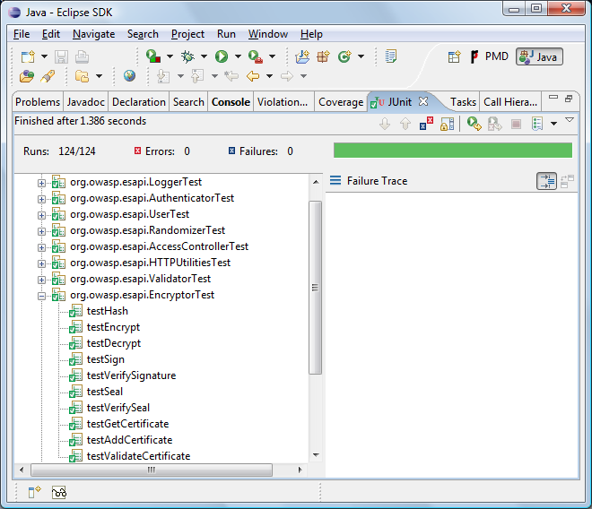

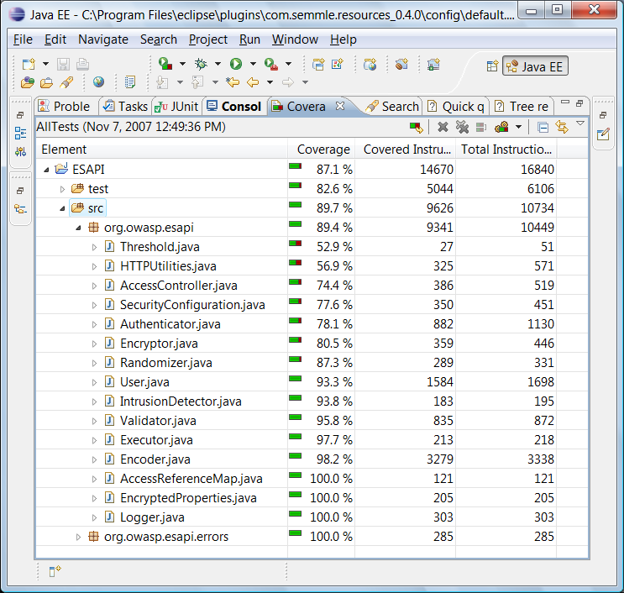


OWASP Project Status

Slide 24
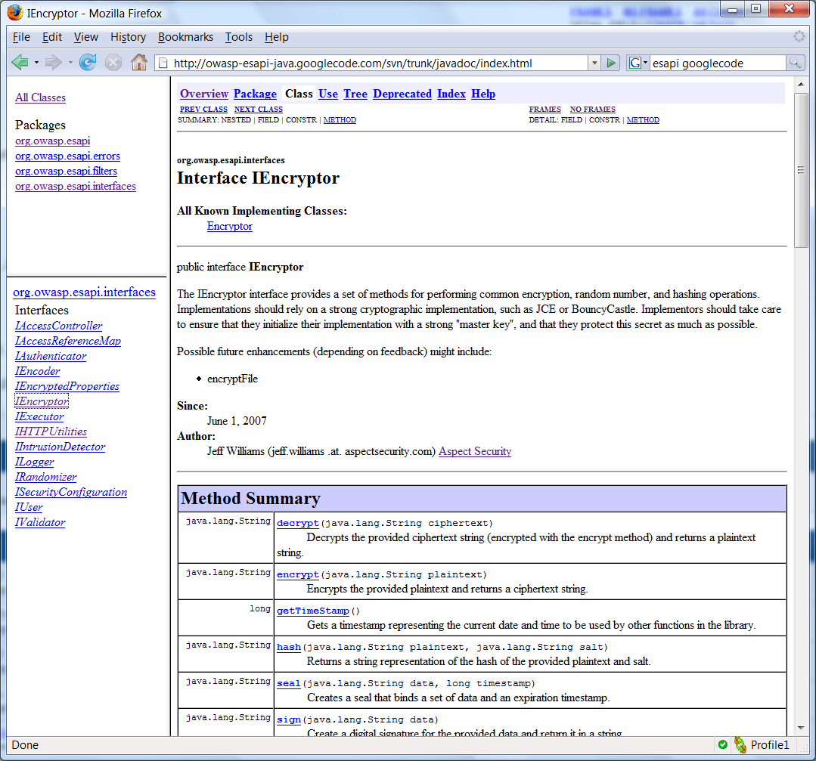
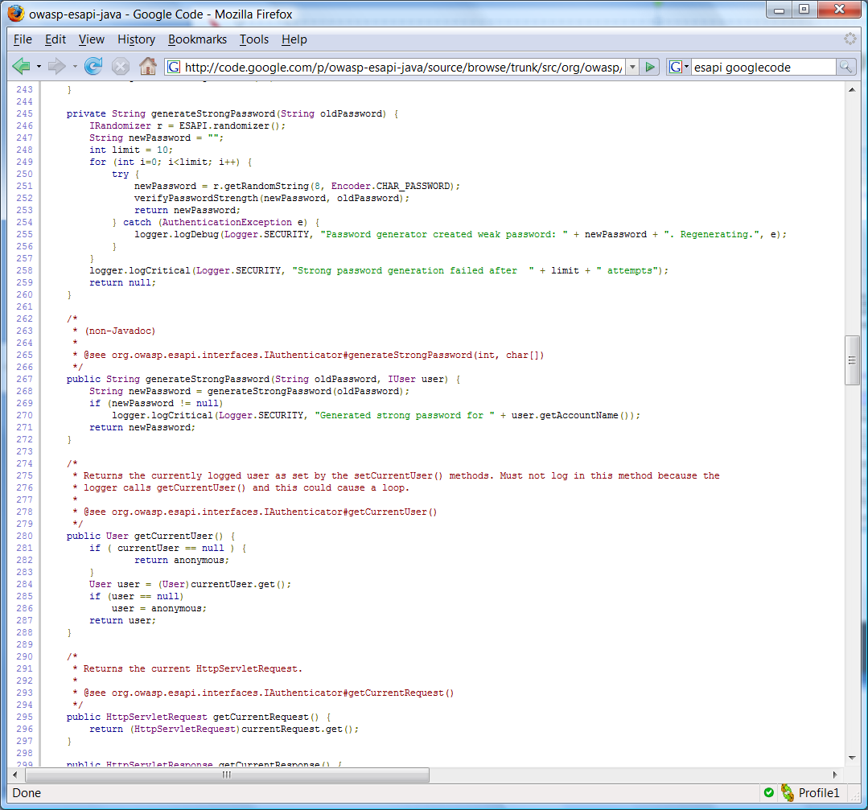
Source Code and Javadoc Online Now!
http://code.google.com/p/owasp-esapi-java

Slide 25
Banned Java APIs
System.out.println() -> Logger.*
Throwable.printStackTrace() -> Logger.*
Runtime.exec() -> Executor.safeExec()
Reader.readLine() -> Validator.safeReadLine()
Session.getId() -> Randomizer.getRandomString() (better not to use at all)
ServletRequest.getUserPrincipal() -> Authenticator.getCurrentUser()
ServletRequest.isUserInRole() -> AccessController.isAuthorized*()
Session.invalidate() -> Authenticator.logout()
Math.Random.* -> Randomizer.*
File.createTempFile() -> Randomizer.getRandomFilename()
ServletResponse.setContentType() -> HTTPUtilities.setContentType()
ServletResponse.sendRedirect() -> HTTPUtilities.sendSafeRedirect()
RequestDispatcher.forward() -> HTTPUtilities.sendSafeForward()
ServletResponse.addHeader() -> HTTPUtilities.addSafeHeader()
ServletResponse.addCookie() -> HTTPUtilities.addSafeCookie()
ServletRequest.isSecure() -> HTTPUtilties.isSecureChannel()
Properties.* -> EncryptedProperties.*
ServletContext.log() -> Logger.*
java.security and javax.crypto -> Encryptor.*
java.net.URLEncoder/Decoder -> Encoder.encodeForURL/decodeForURL
java.sql.Statement.execute -> PreparedStatement.execute
ServletResponse.encodeURL -> HTTPUtilities.safeEncodeURL (better not to use at all)
ServletResponse.encodeRedirectURL -> HTTPUtilities.safeEncodeRedirectURL (better not to use at all)

Slide 26
About Aspect Security
Leaders and managers, testers, architects, threat modeling
Secure coding for developers (hands-on, language-specific)
Application Security
Education and Training Curriculum
Framework and tool tailoring for producing secure code
Integrate key security activities into existing software teams
Acceleration Services
for Software, Security, and Management Teams
Platforms – J2EE, .NET, SAP, Oracle, PeopleSoft, Struts, …
Java, JSP, C/C++, C#, ASP, VB.NET, ABAP, PHP, CFMX, Perl…
Millions of lines of code verified per month
Assurance Services
for Critical Applications
Application security champions in FISMA and SSE-CMM
Exclusive focus on Application Security since 2002
Specialists in
Application Security
Over 180 course offerings per year
Proven application security initiatives
Key contributors to OWASP and authors of OWASP Top Ten
Notes:
Main Point
Teaching Points
Examples, Demonstrations, Stories, Notes

Slide 27

Questions and Answers

Slide 28
Extra Slides

Slide 29
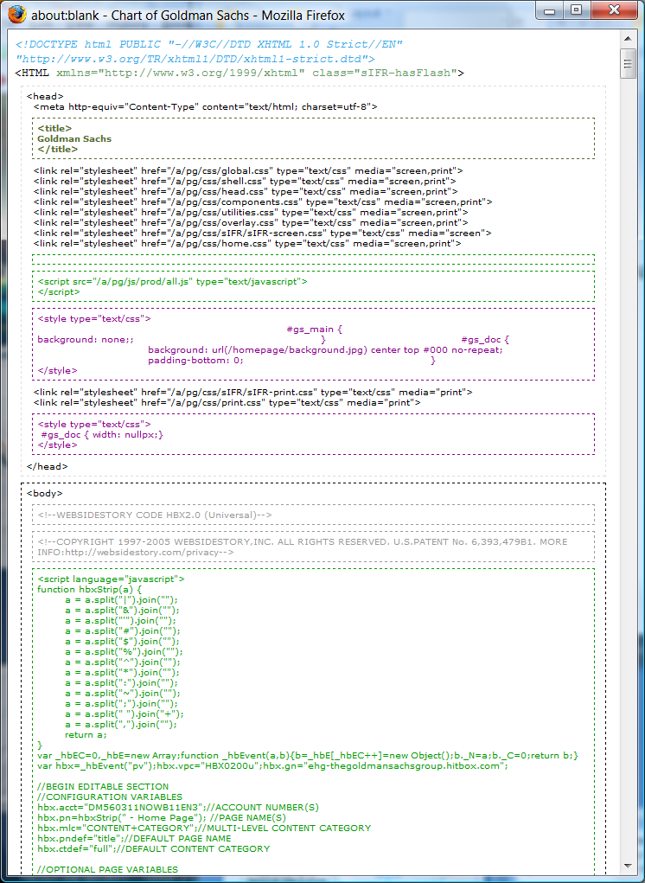
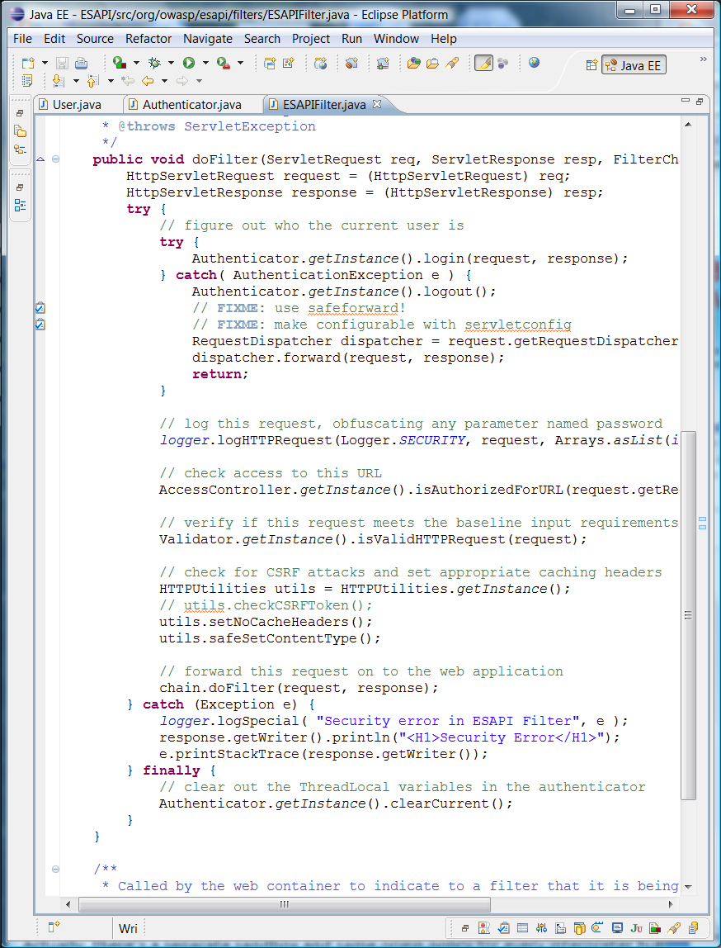
Rich Data == Code
<?xml version="1.0" encoding="ISO-8859-1"?>
<!DOCTYPE note SYSTEM "Note.dtd">
<note>
<to>Tove</to>
<from>Jani</from>
<heading>Reminder</heading>
<body>Don't forget me this weekend!</body>
</note>
<xsl:template match="/">
<xsl:param name="parameter"/>
<xsl:value-of select="$parameter"/>
</xsl:template>
{"text": {
"data": "Click Here",
"size": 36,
"style": "bold",
"name": "text1",
"hOffset": 250,
"vOffset": 100,
"alignment": "center",
"onMouseUp": "sun1.opacity = (sun1.opacity / 100) * 90;"
}
}}
<s:task b:action="xsl-transform" b:stylesheet="$stylesheet" b:datasource="$data" b:destination="id('destination')" >
<s:with-param b:name="parameter" b:select="'123'">
</s:with-param>
</s:task>
Notes:
The first thing we need to discuss is the data that we’re currently passing around on the web. I’m not going to make a big fuss about whether it’s Ajax or RIA or Java EE or AIR or whatever. I say all the data we’re passing around is CODE.
HTML is a mashup of at least 3 languages: HTML, JavaScript, Cascading style sheets - Leads us to 80% of websites containing XSS. JSON is actual executable code. XML - Also injectable, Useful for injecting into backend Web Service payloads
What is Code? Set of instructions that cause something to happen
ActiveX control?
Java applet?
Flash movie?
Javascript embedded in HTML document?
Simple HTML document with <img> tags?
XML document that gets parsed?
A URL?
HTTP request parameter containing injection attack?
All these formats: XML, XSLT, JSON, BXML, HTML, etc… hopelessly mix up data and code. And every time they’re parsed or interpreted they are executed. Now you “run” a web page. Actually this data is really cross-platform executables since they run on all browsers and lots of servers. Worse news: encoding!
Rich data IS code.

Slide 30

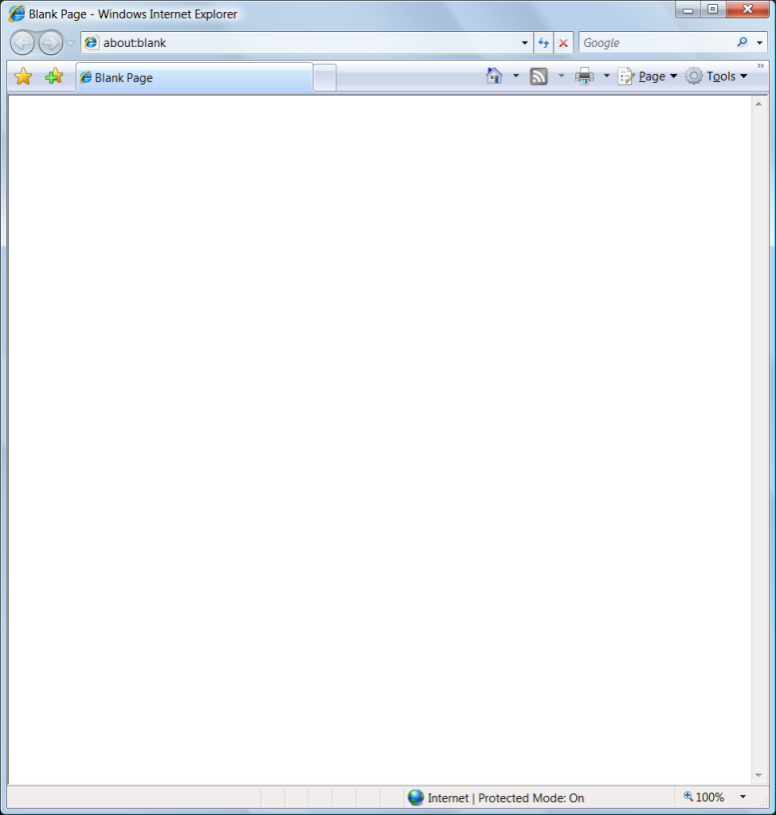
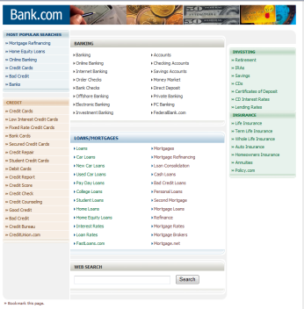
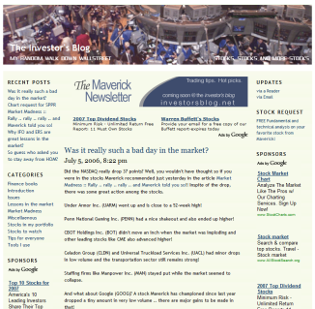
Browser Same Origin Policy
www.mybank.com
XHR
TAG
TAG
XHR
JS
investorsblog.net
document, cookies
Notes:
The SOP *IS* what makes the web secure enough to use.
Imagine if a hacker’s script from a posting on investorsblog.net could access data from your session with mybank.com. There would be no way to “surf” anymore.
Understanding the SOP is critical
The “origin” is really protocol, domain, and port.
The rules in the browser are really quite complex although we give it this simple name
There have been lots of vulnerabilities related to the improper enforcement of the SOP

Slide 31
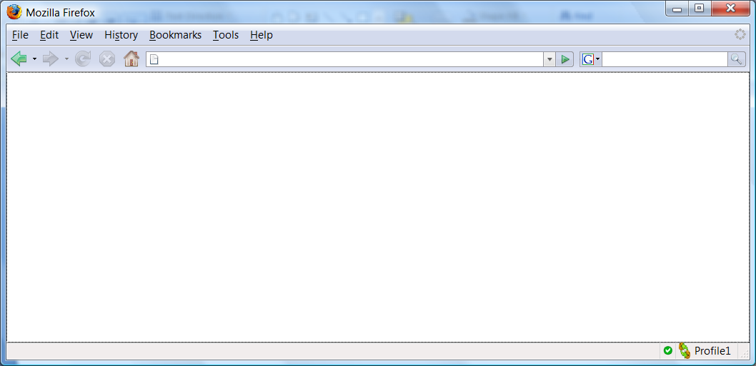
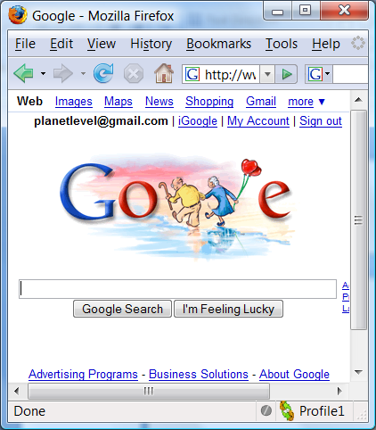
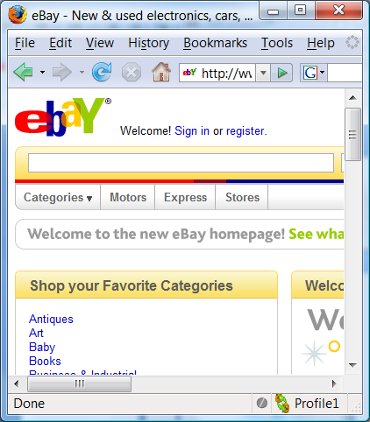
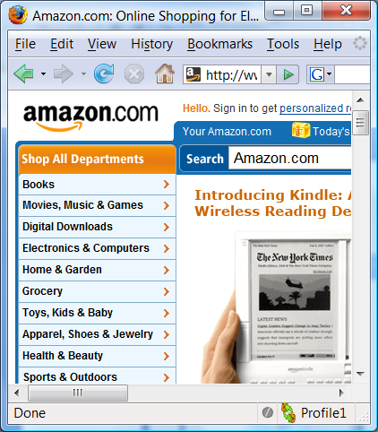
Browser == Operating System
Javascript Engine
Java
Engine
Flash
Engine
Quicktime
Engine
Acrobat
Reader
Silverlight, etc…
Javascript Engine
Operating System
Notes:
So the browser is running programs from multiple different sites, and it has to keep those applications from affecting each other. That’s essentially what we used to call the operating system.
The browser has a “sandbox“ that prevents code from getting to the OS (mostly). That’s the floor in the picture.
The same origin policy is like the walls – it protects code from getting to other data and code in other rooms. This is critical if you’re going to run code from lots of different sites.
<click>
Actually, there’s a separate sandbox and same origin policy for every interpreter built into the browser: Javascript, Java, Flash, Acrobat Reader, Quicktime. And coming soon, Silverlight, AIR, JFX.
And they each enforce slightly different rules.
And they all can share data through the DOM
And data is code!!!

Slide 32
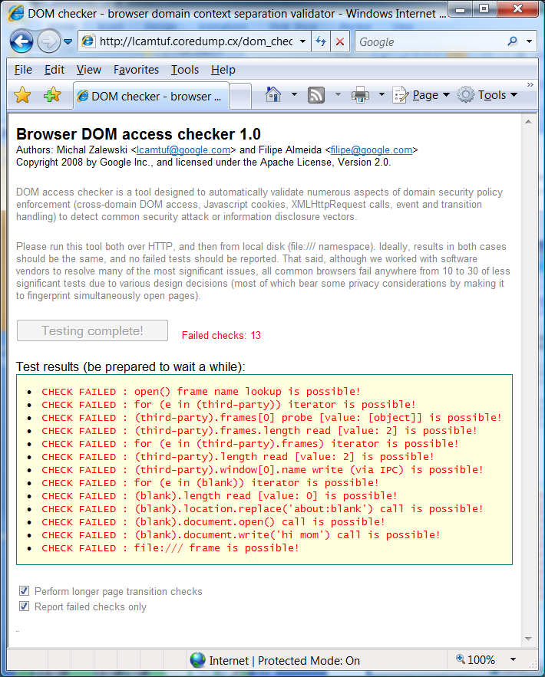
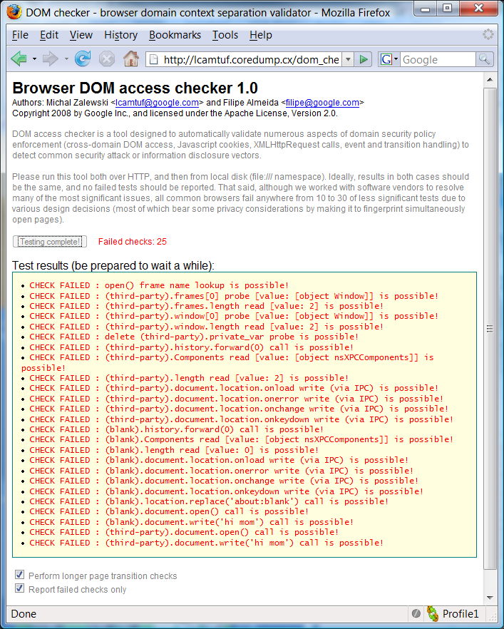
DOM Checker
http://code.google.com/p/dom-checker/
IE 7.0.6… latest patches (remote)
Firefox 2.0.0.12 latest patches (remote)
Notes:
The SOP is quite complex. This little tool from two guys at Google basically just explores the SOP enforcement from within JavaScript. There are roughly 1400 tests (1392) in the toolkit. You can see that the enforcement is different in IE7 vs. Firefox.

Slide 33
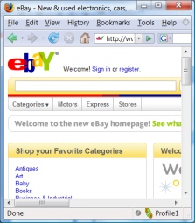
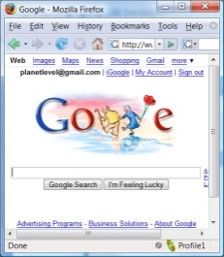

Network == Computer
<!-- deploy program in website and wait -->
<program>
loop through top 100 banks {
use local credentials to attempt access to bank
if access allowed {
pull list of attacks from storage
attack 1: use checking service to steal $99
attack 2: post this comment to a blog
...
}
}
</program>
Internet API
Storage
Services
CPU, Identities, and Access
Notes:
Now I want to zoom out even a little farther. Attackers are actively trying to figure out how to exploit this ecosystem.
Storage is amply available on the Internet. Examples range from blog comments, social network sites, gmail, to rss feeds. If you can store data, you can store programs.
Services are widely available to transform, update, distribute, and manipulate data (and programs)
And browsers offer ample access to processing. Browsers also happen to contain lots of identities and access to websites that wouldn’t ordinarily be accessible. They act like a bridge to private networks.
Attackers are looking for ways to get their code to run somewhere where they can get access to valuable stuff. How can they get their code to spread? What could you write with an API like that?

Slide 34
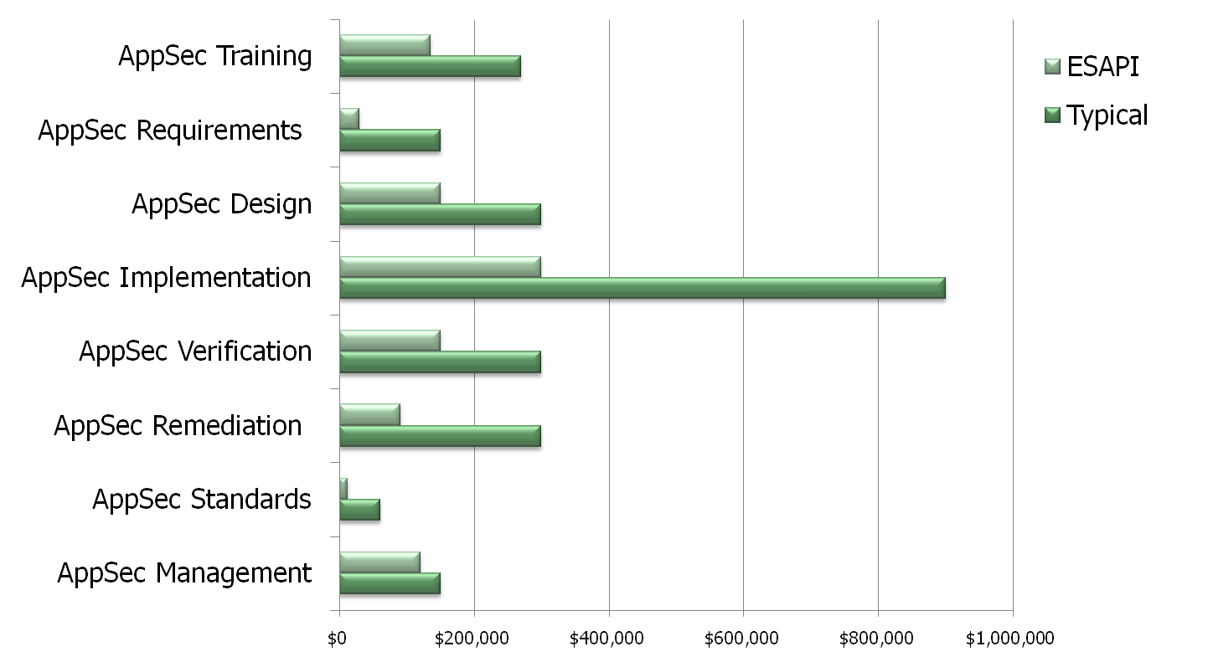
Potential Enterprise ESAPI Cost Savings

